Slide 1


Slide 2
Welcome!
6 – 6.30pm Arrival
6.30pm – 8.00pm Talks
Nic Crane, Elucidata: Welcome, R community news, and RStudio conference highlights
Adnan Fiaz, RedBrain: “There is no R in Cloud: A talk about fantastic Clouds and where to find them (with R)”
Martin Hadley, Visible Data: “Reproducible workflows for interactive visualisations with R, htmlwidgets and shiny”
8pm – 9pm Drinks, snacks, and socialising

Slide 3

Thanks to our sponsor!

Slide 4
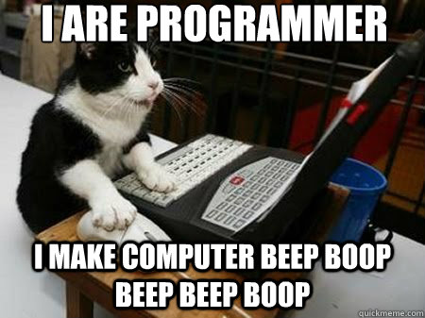
What is BristolR?
Community-led, community-driven R meetup
Accessible to people with different levels of prior knowledge

Slide 5
Code of Conduct
We follow the R Consortium and R Community code of conduct (https://wiki.r-consortium.org/view/R_Consortium_and_the_R_Community_Code_of_Conduct).
Any concerns or questions? Contact Nic (thisisnic@gmail.com)

Slide 6
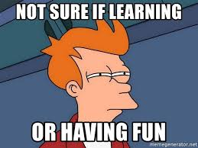
Aims
Organise regular meetups that are fun and interesting
Get R consortium funding
Grow!

Slide 7
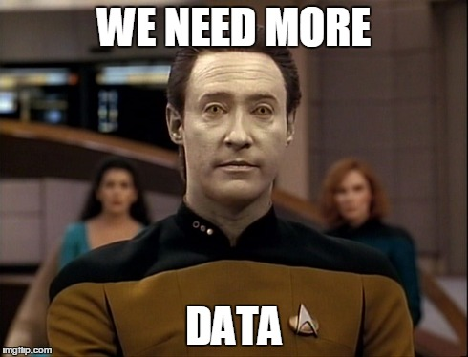
BristolR Community Survey
Sent out in December 2018
Some of you might not have seen it (sorry!)
Will be regularly collecting data from attendees

Slide 8
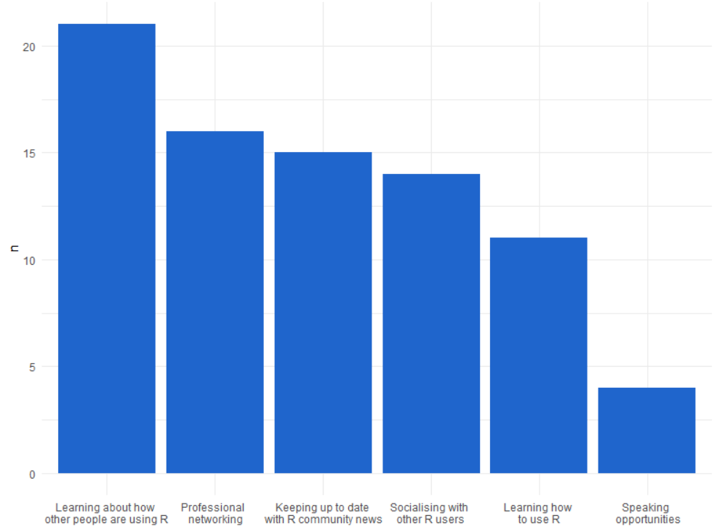
Question 1: “What do you want to get out of BristolR?”

Slide 9
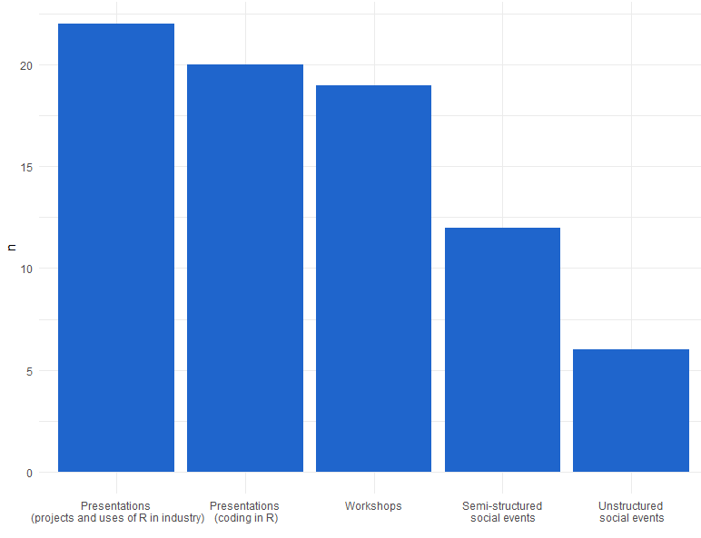
Question 2: “What kind of meetings do you want to see at Bristol R?”

Slide 10
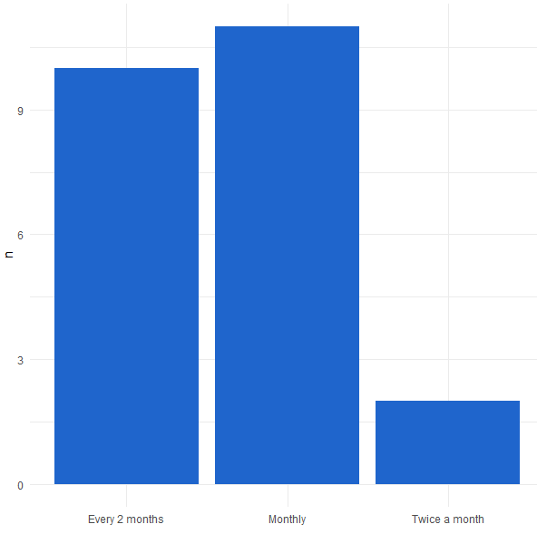
Question 3: “How frequently are you likely to attend meetups?”

Slide 11
Question 4: “In your opinion, what makes for a great user event?”
Applicable to users of different levels of prior knowledge
Hands-on experience/practical demonstrations
Positivity, encouragement, and humour
Interesting talks & engaging presenters
Non-commercial environment
Opportunity to network

Slide 12
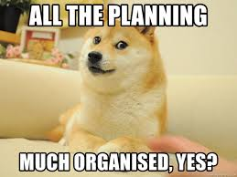
Short Term Goals
RMarkdown workshop (late February/early March)
Speakers!
Venue sponsors
Org. team

Slide 13
R Community News/RStudio Conference
RStudio Conference (15th – 18th January 2019; Austin, Texas)
Talks are now online!
Tidyverse Developer Day (19th January, 2019; Austin Texas)

Slide 14
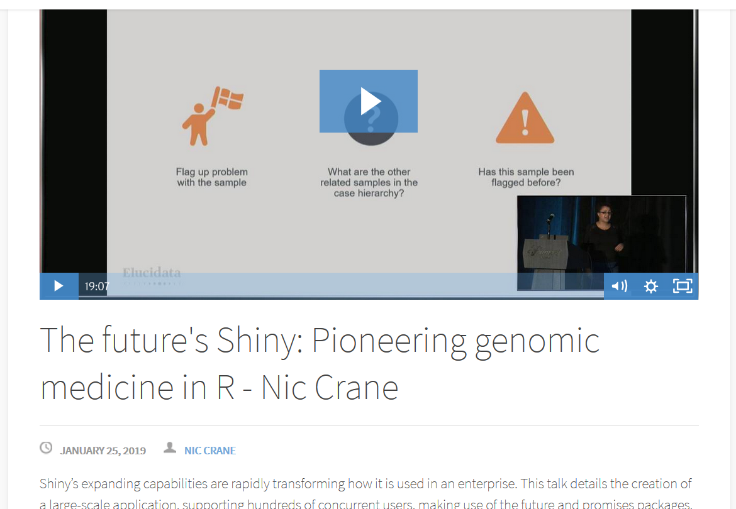
“The Future’s Shiny: Dashboard for Pioneering Genomic Medicine in R” – Nic Crane
https://bit.ly/2Tl3QEn

Slide 15
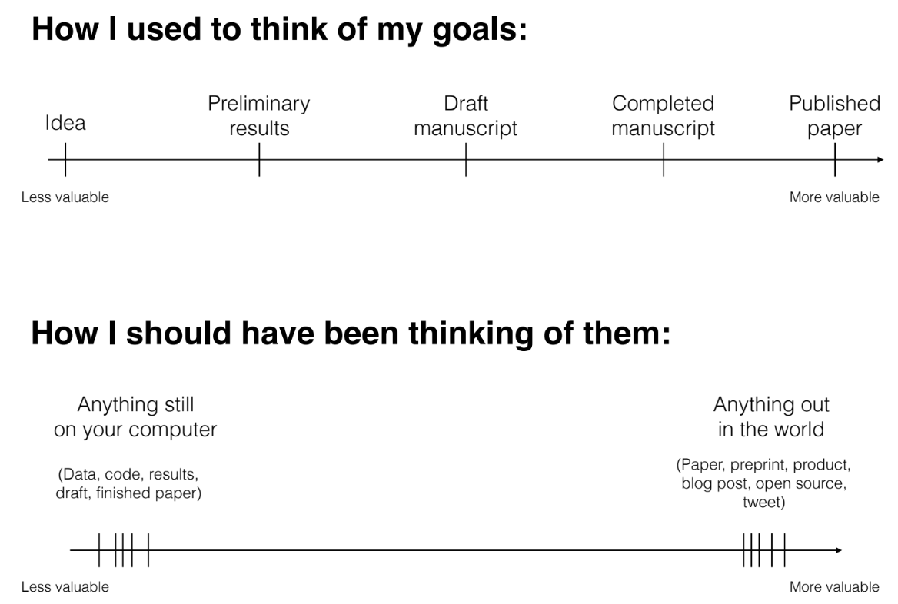
“The unreasonable effectiveness of public work” – David Robinson

Slide 16
“gganimate live cookbook” - Thomas Lin Pedersen

Slide 17
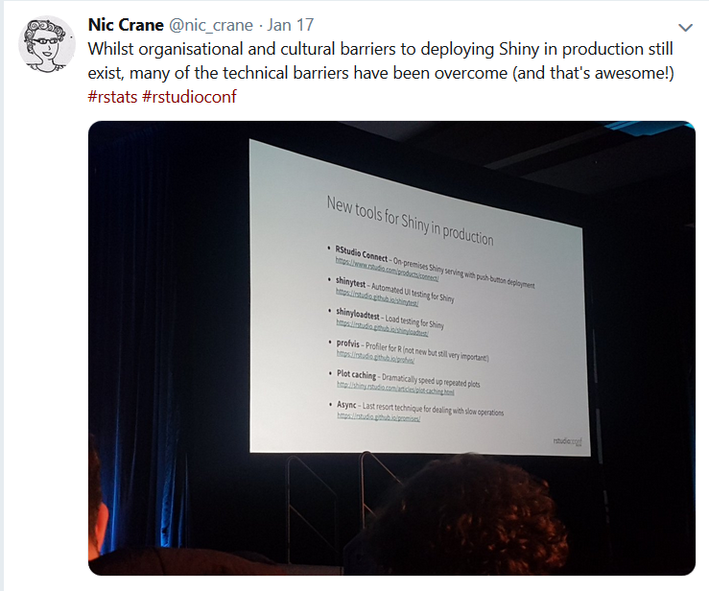
“Shiny in production: Principles, practices, and tools” – Joe Cheng

Slide 18
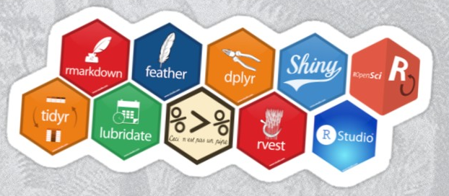
#BristolR
Help get the word out about BristolR!
Tweets about BristolR and get first dibs on the hex stickers!
Tweet with photo > tweet without photo
(Nic take selfie with audience now)

Slide 19
Next Up…
Adnan Fiaz, RedBrain: “There is no R in Cloud: A talk about fantastic Clouds and where to find them (with R)”
Martin Hadley, Visible Data: “Reproducible workflows for interactive visualisations with R, htmlwidgets and shiny”

